Slide 1



Mini Project - Data Analysis
Lydia Manzanares
Data Science and Machine Learning

Slide 2

Challenge
Ironhack Payments
It is a financial services company, offering a cash advance solution service
It wants to understand what is their monthly cohort evolution usage for the cash advances service

Slide 3
Data Cleaning
Remove deleted user
Converted float to int
Extract the date as date format (datetime)
Choose the columns which were useful

Slide 4
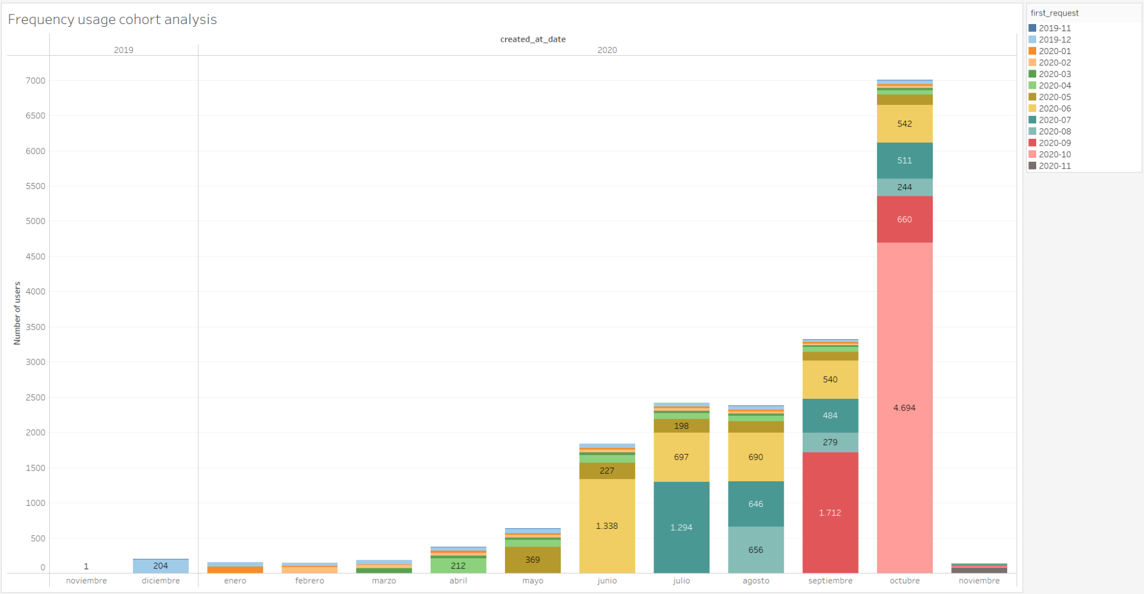
Frequency usage by cohort
Assumptions
Based on user_id, calculated the first cash_request
Cash request as the base of the analysis

Slide 5
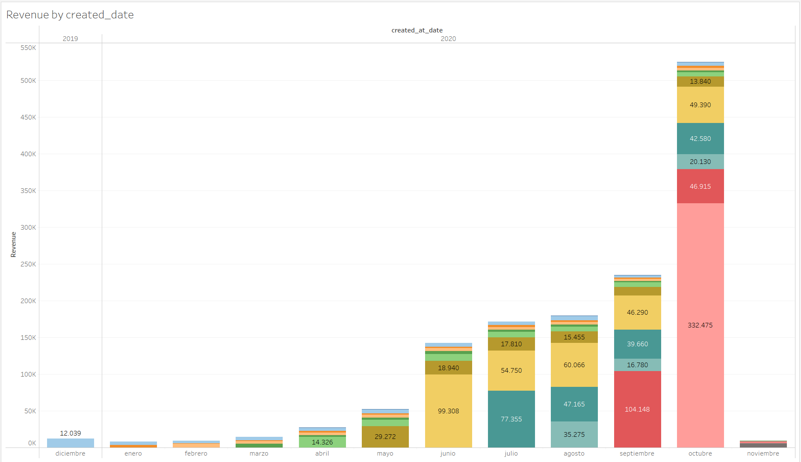
Revenue analysis
Assumptions
Revenue is the sum of total amount and fees
Filter by status = money back

Slide 6
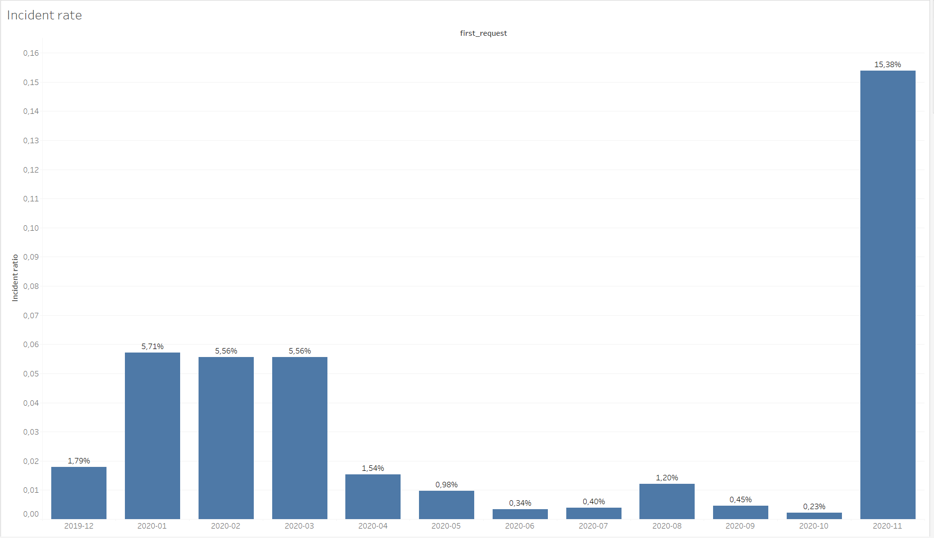
Incident Rate
Assumptions
Calculated incident with the recovery_status

Slide 7
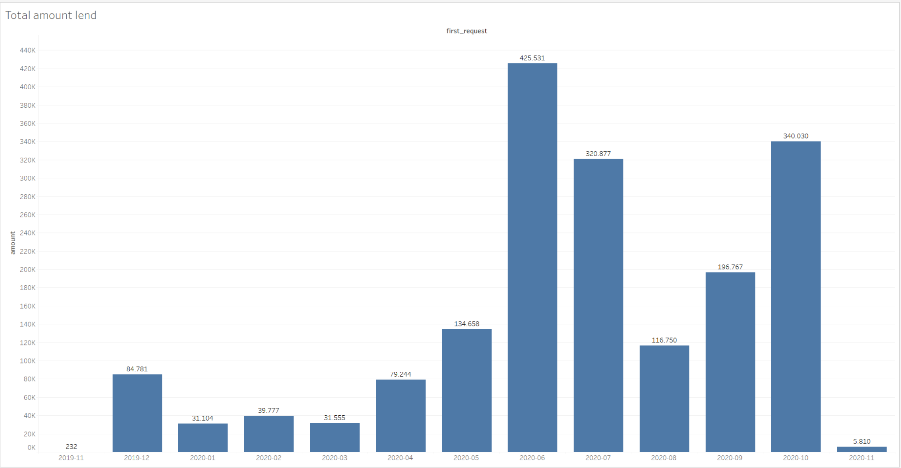
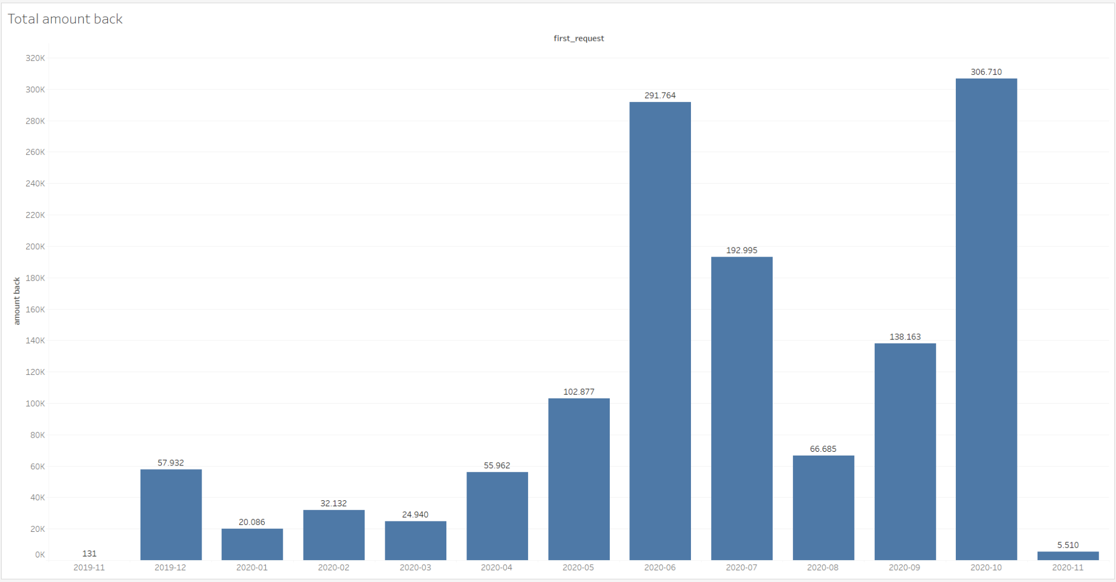
Amount lend & Amount recovered

Slide 8
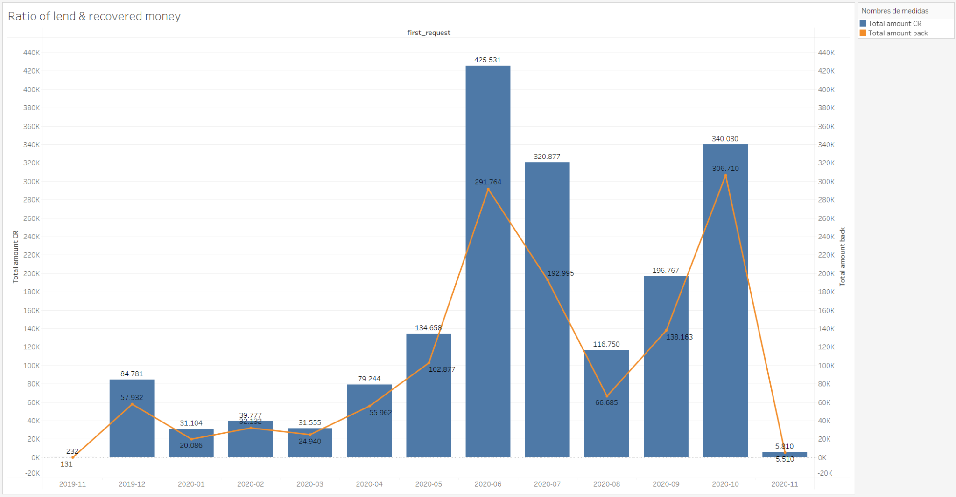
Amount lend & Amount recovered

Slide 9
Thank you!

Slide 10
Tableau dashboard

